Slide 1
Standardised usage statistics from repositories (IRUS)
Ross MacIntyre, Head library analytics services, Jisc
COAR Workshop: On the Road to New Metrics
Hamburg, May 2018

Slide 2
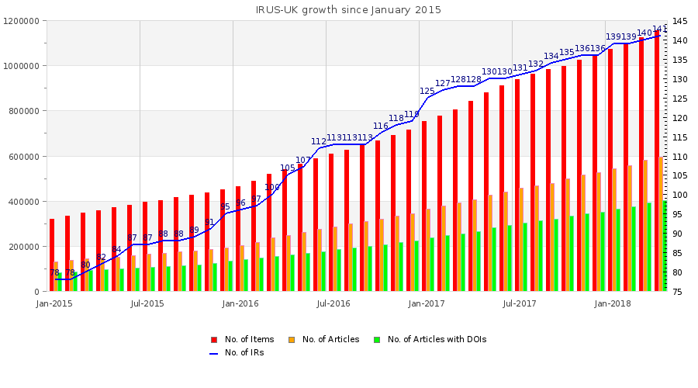
What is IRUS-UK?
A national aggregation service for UK Institutional Repository Usage Statistics:
Collects raw download data from UK IRs for *all item types* within repositories
Processes raw data into COUNTER-conformant statistics - so produced on the same basis as ‘traditional’ scholarly publishers
Notes:
IRUS-UK is a national aggregator of repository usage statistics. Its purpose is to collate and provide institutions with access to reliable, accurate standard-based usage statistics for their institutional repository.
This enables them to gain a better understanding of the usage of their institution's research, which they can then share with key internal and external stakeholders.
IRUS-UK collects data on all downloads from the institutional repository, (not just articles), and processes the data into COUNTER-compliant usage statistics.

Slide 3
Who is responsible for IRUS-UK?
Funded by Jisc
Team Members:
Jisc – Service Management & Host
Cranfield University – Service Development & Maintenance
Evidence Base, Birmingham City University – User Engagement & Evaluation
Bringing together key repository services to deliver a connected national infrastructure to support OA
Notes:
IRUS-UK is funded by Jisc as part of the Repository Shared Services Project, which includes services to support all stages of workflows for UK institutional repositories such as deposit, metadata, discovery, and usage statistics.
The IRUS-UK team is a consortium utilising expertise from the same group supporting JUSP, the Journal Usage Statistics Portal. This includes:
Jisc, who host the service and provide project and service management
Cranfield University, who provide technical development
Evidence Base at Birmingham City University, who support evaluation and user engagement

Slide 4
About COUNTER
Counting Online Usage of Networked Electronic Resources
an international initiative serving librarians, publishers and intermediaries
setting standards that facilitate the recording and reporting of online usage statistics
consistent, credible and comparable
COUNTER Codes of Practice:
Release 4 of the COUNTER Code of Practice for e-Resources
Books, databases , journals and multimedia content
Release 1 of the COUNTER Code of Practice for Articles
Journal articles
Release 1 of the COUNTER Code of Practice for Usage Factors
Alternative metric to the Journal Impact Factor
The Codes specify:
How raw data should be processed into statistics
How statistics reports should be formatted and delivered

Slide 5
The Tracker Protocol
To enable repositories to participate in IRUS-UK a small piece of code is added to repository software, which employs the ‘Tracker Protocol’
http://irus.mimas.ac.uk/documents/TrackerProtocol-V3-2017-03-22.pdf
Patches for DSpace (4-6.x) and Plug-ins for Eprints (3.2-3.3.x)
Implementation guidelines for Fedora/Hydra/Samvera
Implementations developed for PURE portal and figshare
The Tracker Protocol was devised in collaboration with and is endorsed by COUNTER
Gathers basic data for each raw download and sends to IRUS-UK server
Raw download data is stored in daily logfiles before being processed and ingested into IRUS-UK database
Notes:
IRUS works by adding a small piece of code to repository software which employs the ‘Tracker Protocol’. The tracker is available for DSpace, EPrints, and we have implementation guidelines for Fedora.
The tracker gathers basic data for each download and sends it to the IRUS-UK server. The tracker protocol adheres to Release 4 of the COUNTER Code of Practice for e-Resources and Release 1 of the COUNTER Code of Practice for Articles.
On a daily basis, the data goes through a number of filters and checks before being added to the portal, and is then reviewed again at the end of each month. These process help ensure robot activity or other unusual activity is spotted and removed to improve the accuracy of the data.

Slide 6
IRUS-UK ingest procedures
The IRUS-UK daily ingest follows processing rules specified in:
Release 4 of the COUNTER Code of Practice for e-Resources
Release 1 of the COUNTER Code of Practice for Articles
Processes entries from recognised IRs
Sorts and filters entries following COUNTER rules to remove robot entries using the COUNTER User Agent Exclusion List
regarded as a minimum requirement for excluding bots, etc.
Filters entries using additional IRUS-UK filters
Filters entries by applying the COUNTER 30 second double-click rule
Consolidates raw usage data for each item into daily statistics
At the end of each month, daily statistics are consolidated into monthly statistics
Notes:
IRUS works by adding a small piece of code to repository software which employs the ‘Tracker Protocol’. The tracker is available for DSpace, EPrints, and we have implementation guidelines for Fedora.
The tracker gathers basic data for each download and sends it to the IRUS-UK server. The tracker protocol adheres to Release 4 of the COUNTER Code of Practice for e-Resources and Release 1 of the COUNTER Code of Practice for Articles.
On a daily basis, the data goes through a number of filters and checks before being added to the portal, and is then reviewed again at the end of each month. These process help ensure robot activity or other unusual activity is spotted and removed to improve the accuracy of the data.

Slide 7
Robots & rogue usage – IRUS-UK current approach
As stated, the COUNTER Robot Exclusion list is a minimum requirement for eliminating robots and rogue usage
It worked well for traditional scholarly publishers with resources behind a subscription barrier
As we move to an OA world and newer players – repositories – more needs to be done
So in addition IRUS-UK:
excludes several IP ranges that are associated with some known robots and spiders, which don’t identify themselves in their User Agent string
And based on several years of empirical evidence:
exclude downloads from IP addresses with 40+ downloads in a day
Exclude downloads from IP address/User Agent where a single item is downloaded 10+ times a day
Though we are aware that more can still be done
More on robots later, but next a diagrammatic summary of the ingest . . .
Notes:
IRUS works by adding a small piece of code to repository software which employs the ‘Tracker Protocol’. The tracker is available for DSpace, EPrints, and we have implementation guidelines for Fedora.
The tracker gathers basic data for each download and sends it to the IRUS-UK server. The tracker protocol adheres to Release 4 of the COUNTER Code of Practice for e-Resources and Release 1 of the COUNTER Code of Practice for Articles.
On a daily basis, the data goes through a number of filters and checks before being added to the portal, and is then reviewed again at the end of each month. These process help ensure robot activity or other unusual activity is spotted and removed to improve the accuracy of the data.

Slide 8
IRUS-UK Daily Ingest
Daily Ingest Scripts
IP Excludes (textfile)
40+ downloads
129 repositories
Raw download data
PreStep1
Check Repository details.
Generate exclude files.
List unknown hosts
IP/UA/ID Excludes
(textfile)
10+ downloads of a single item
Daily log files
Step1
Remove COUNTER & IRUS-UK exclusions & dbl-clicks
Consolidate raw data into stats
Intermediate stats (textfile)
Step2
Insert new, unknown items into Item table.
Lookup irus-uk item ids via OAI identifiers and
Insert stats into Daily Stats table
Insert new manifest data
Manifest (textfile)
Manifest Table
Item Table
Daily Stats Table
Recent Daily Stats Table
IRUS-UK Database
RecentDailyStats
Regenerate latest 30 days table (for performance in UI)
Step3
Harvest bibliographic metadata for unknown items
129 OAI-PMH interfaces

Slide 9
IRUS-UK Monthly Update
Monthly Update Script
Daily Stats Table
Monthly Stats Table
Monthly Summary Stats Table
IRUS-UK Database
Monthly-Update yyyy-mm
Consolidate daily stats for yyyy-mm into monthly stats (required COUNTER granularity) and update Monthly Stats table
Consolidate daily stats for yyyy-mm into monthly summary stats and update Monthly Summary Stats table (for performance in UI)

Slide 10
Viewing/retrieving IRUS-UK statistics
Web User Interface - The IRUS-UK Portal
Access currently behind Shibboleth authentication/authorisation
Wide range of views, slicing and dicing stats from the IRUS-UK database
Reports available for download as TSV/CSV/Excel spreadsheet files
SUSHI service
XML SOAP service
for more info see: http://www.niso.org/workrooms/sushi/
SUSHI Lite API
Under development by the NISO SUSHI Lite Technical Report Working Group (http://www.niso.org/workrooms/sushi/sushi_lite/)
Allows retrieval of stats reports and snippets as JSON to be embedded into Repository (and other) web pages, or ingested into other services
Example client: http://www.irus.mimas.ac.uk/api/sushilite/v1_7/Client/
Notes:
Once the data has been checked it is accessible via the web user interface in the IRUS-UK portal, which is accessed via Shibboleth authentication. Within the portal there are a wide range of views, showing the data in various different forms of reports. All the reports are available for download as CSV/Excel spreadsheets.
The IRUS data can also be viewed via SUSHI service, and a SUSHI Lite API which is currently being developed in collaboration with the NISO SUSHI Lite Technical Report Working Group. The API allows retrieval of statistics to embed in other places (e.g. repository).

Slide 11
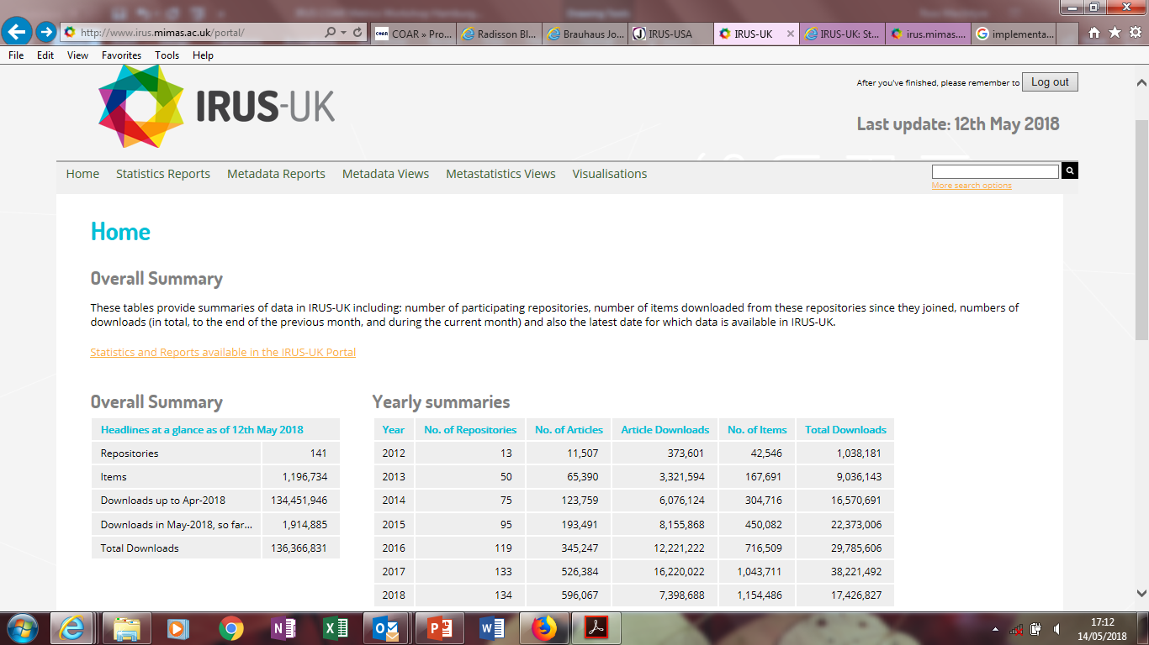
IRUS-UK: Home
Notes:
A few example screenshots . . .

Slide 12
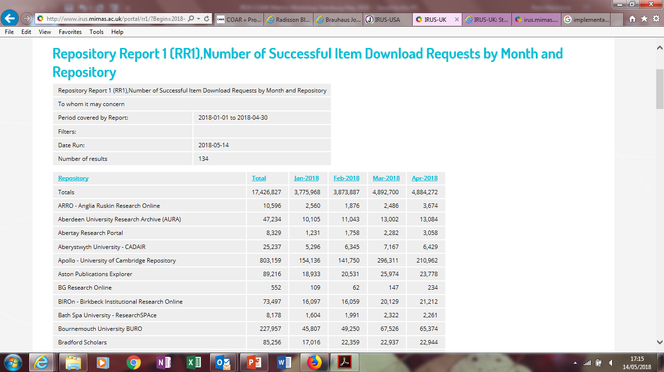
IRUS-UK: Repository Report 1
Notes:
The Repository Report 1 shows the number of successful item downloads requests by month and repository. You can select on the previous screen which months you would like to look at, and the report will show usage across all repositories for those months. You can sort within the portal, or you can export to Excel for further analysis (e.g. to support benchmarking).

Slide 13
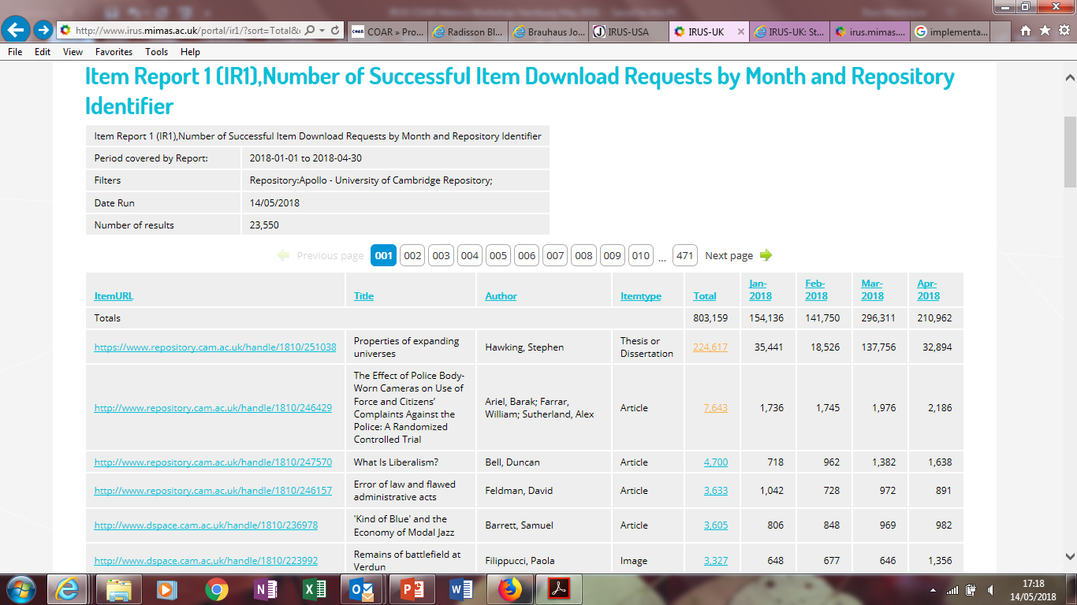
IRUS-UK: Item Report 1
Notes:
The Item Report 1 goes into more detail for each repository. From this report you are able to view downloads at an item level. Again you can select a date range, and sort within the portal (e.g. to see which items have received the most downloads). From this page you can also get to a more detailed view in the Item Statistics report which I’ll show in a few minutes.

Slide 14
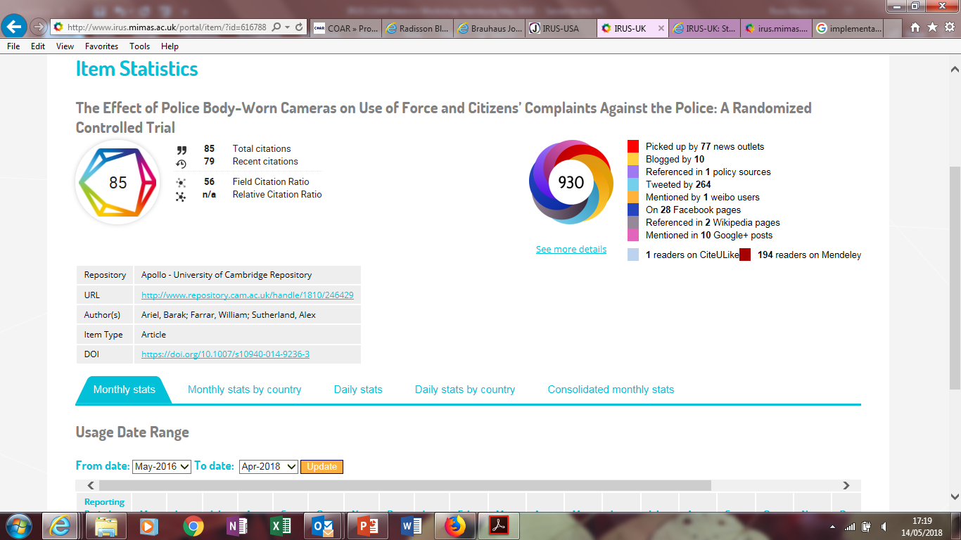
IRUS-UK: Item Statistics
Notes:
The Item Statistics shows a more detailed view of usage for a particular item. You can see in the screenshot that there is both tabular and graphical representation of downloads, as well as more metadata. For some items (including this one) there is also Altmetrics information which includes use on social media.
Hopefully that quick tour has shown you some of the data you can get from IRUS - I haven’t included all reports, and more are being added all the time via user requests and feedback.

Slide 15
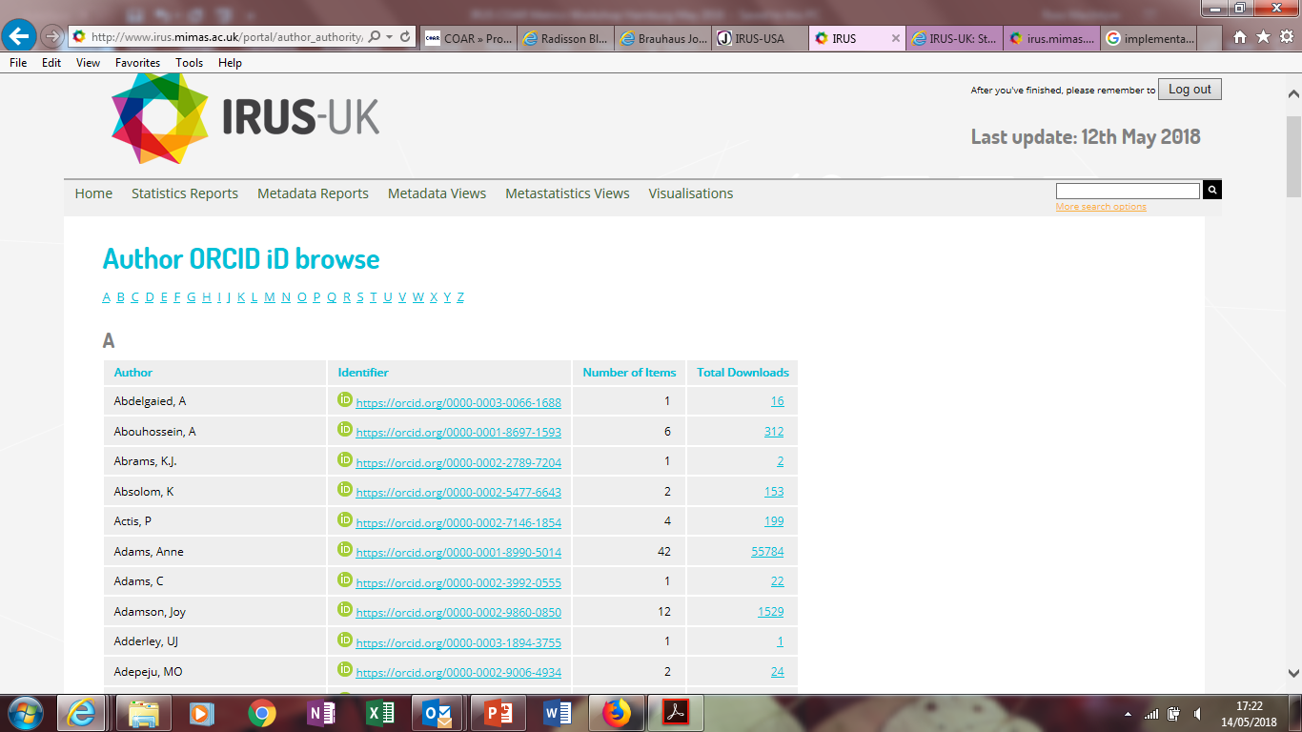
IRUS-UK: ORCID

Slide 16
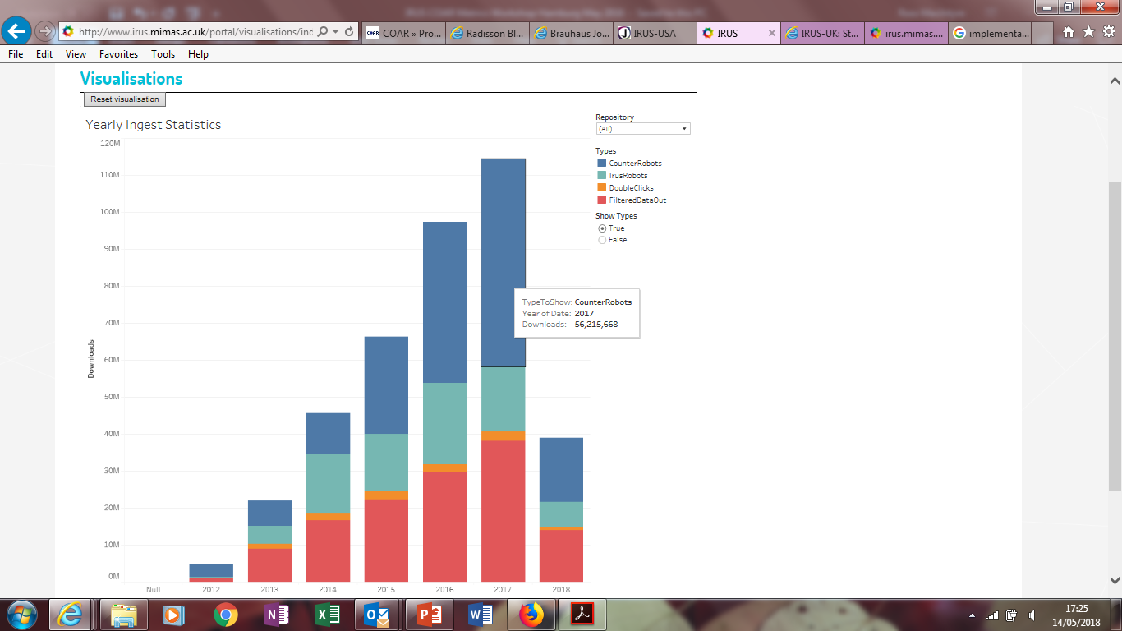
IRUS-UK: Visualisation - Ingest Statistics

Slide 17
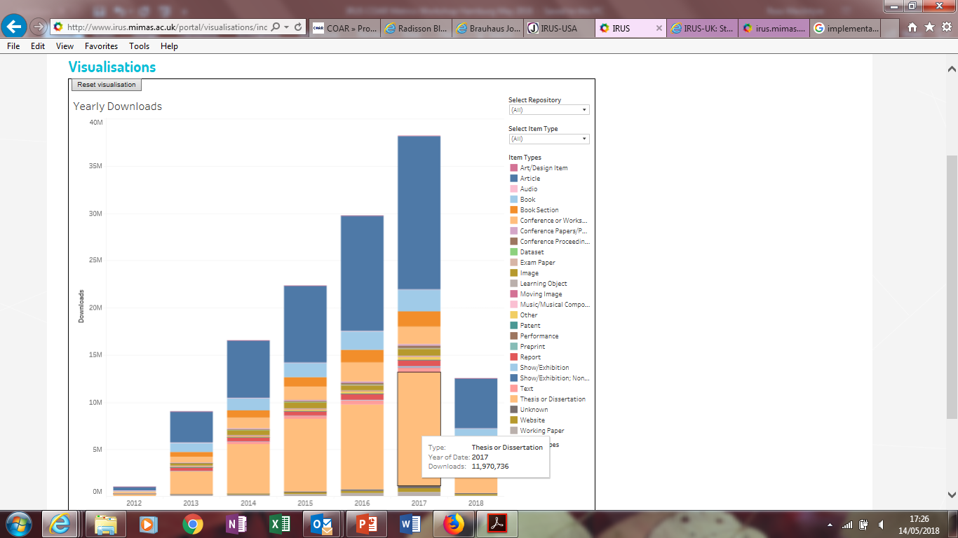
IRUS-UK: Visualisation – Yearly Downloads

Slide 18
What next?
Standards development:
COUNTER Robots Working Group
COUNTER Release 5
Other IRUS services:
Research Data: IRUSdata
IRUS-CORE
IRUS-OAPEN
New user communities:
IRUS-USA
IRUS-ANZ

Slide 19
Contacts & Information
IRUS-UK web site:
http://irus.mimas.ac.uk/
Contact IRUS-UK:
irus@mimas.ac.uk
@IRUSNEWS
COUNTER web site:
http://www.projectcounter.org/
Contact COUNTER:
http://www.projectcounter.org/contact.html
@projectCOUNTER
Notes:
You can find lots more information about IRUS on our website, and if you’d like to contact us you can email us. We’re also on Twitter so feel free to follow us and contact us that way if you prefer.

