Slide 1
Data that Counts
Charleston Conference, 6 November 2015
Lorraine Estelle, COUNTER & Jo Lambert, Jisc
Photo by e y e / s ee CC-BY
Notes:
Photo by CC-BY

Slide 2
maintains reliable, consistent and credible usage statistics
international initiative aiming to improve bibliometrics
community-led initiative supported by member fees
free and open standard: CODE OF PRACTICE
Notes:
This 5 minute introduction will outline what COUNTER is and what it does

Slide 3
Usage stats tools (enabled by COUNTER & NISO)
Notes:
Practical tools that are built on COUNTER standard
Brief overview of JUSP and IRUS-UK
How they are used in practice

Slide 4
Journal Usage Statistics Portal (JUSP)
Supports libraries by providing a single point of access to e-journal usage data
Assists management of e-journals collections to inform evaluation and decision-making processes
Enables usage comparisons and trend analysis

Slide 5
Using JUSP
Making effective use of staff time
Assisting academic departments in understanding resource use
Data for regular reporting and decision making
Informing decisions for substitutions and cancellations
Benchmarking usage
Use cases:http://www.jusp.mimas.ac.uk/use-cases/
Photo by MacEntee CC-BY
Photo by Indigo Skies Photography CC-BY

Slide 6
Standards based measurement
‘’Usage statistics are used to inform important decisions and we really want to be sure we can rely on the accuracy of the data; with JUSP we know we can. We will often present this information to academics and it will be scrutinised so it’s important for us to be sure that the data is reliable.”
Birkbeck, University of London (speaking of JUSP)

Slide 7
Institutional Repository Usage Statistics (IRUS-UK)
A national aggregation service, enabling UK IRs to share/expose usage statistics at the individual item level, based on a global standard – COUNTER
Collect raw download data from UK IRs for *all item types* within repositories
Process those raw data into COUNTER-compliant statistics

Slide 8
Using IRUS-UK
Providing standards-based, reliable repository statistics
Reporting to institutional managers & researchers
Analysing trends over time
Benchmarking
Supporting advocacy
http://www.irus.mimas.ac.uk/help/support/
Photo by .craig CC-BY

Slide 9
Standards based measurement
“What helps is that it’s independent and COUNTER- compliant... the fact that it is independent and standards compliant is really important.”
The Open University (speaking of IRUS-UK)

Slide 10
Incorporating IRUS-UK stats into an eprints IR
IRUS-UK supports The Open University:
Independent analysis of full download record
COUNTER compliance – no local effort
Benchmarking with 89 other UK IR’s
Consistent processing across wide base
Many useful reports e.g. duplicate DOIs
http://oro.open.ac.uk/43210/
Stiles, Alan (2015). Incorporating IRUS-UK statistics into an EPrints repository. In: OR2015:10th International Conference on Open Repositories, June 8-11, 2015, Indianapolis, Indiana, USA.
Photo by Glas CC-BY

Slide 11
Challenges
Photo by Sunter CC-BY

Slide 12
Opportunities
Avoiding duplication of effort to enable greater efficiencies
Collective voice to influence change
Connecting communities libraries, publishers, standards organisations
Shared experience of managing usage statistics
Photo by Chandar CC-BY

Slide 13
USUS
Established 2014
COUNTER supported but editorially independent
Forum – usage, issues, standards
http://www.usus.org.uk/
Photo by Rayker CC-BY

Slide 14
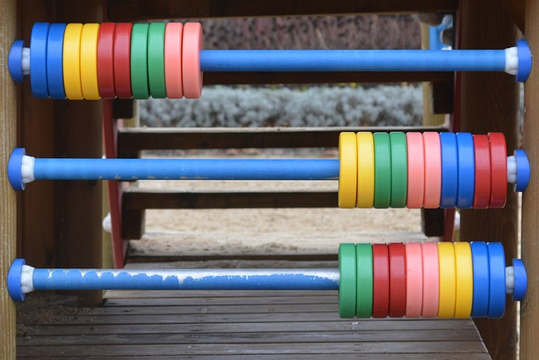
stakeholder consultation
community-led expert input
Continuous engagement informing the standards and services
RELEASE 5
in 2017
Improving the utility of the COUNTER CODE OF PRACTICE
Notes:
This slide will outline the steps COUNTER will take to improve the utility of the Code of Practice over the next 18 months – and focus on two stage consultation process – making it easier to use and implment

Slide 15
Questions
What would you like to see to enable development of shared tools and services such as JUSP and IRUS-UK?
If you’re a publisher can you comment on some of their challenges?
What should we prioritise tackling internationally that can’t be done nationally or locally?
What are your recommendations with regard to COUNTER development?

Slide 16
Image credits
Eye/see: https://flic.kr/p/9UAzzu
Fysh: https://flic.kr/p/axtCvY
Indigo Skies Photography: https://flic.kr/p/idaSVM
.craig: https://flic.kr/p/58GTvm
Glas: https://flic.kr/p/4zwtRh
Sunter: https://flic.kr/p/kkzVBH
Chandar: https://flic.kr/p/e88czY
Rayker: https://flic.kr/p/4st712

